Slide 1
ETL TESTING

Slide 2
What is ETL Testing?
ETL stands for Extract-Transform-Load
Why we perform ETL Testing?
The Extract, Transform, and Load (ETL) process is the primary process used to effectively load data from source systems to the data warehouse

Slide 3
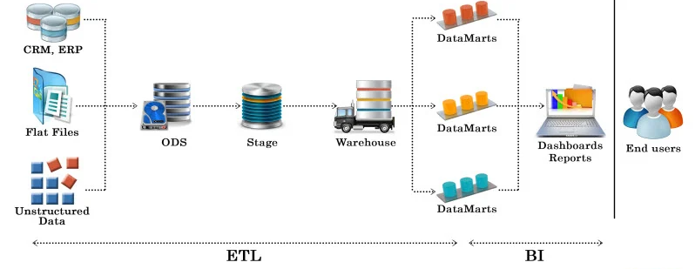

Slide 4
Difference between Data warehouse and data mart
Data warehouse | Data mart
A Data Warehouse is a large repository of data collected from different organizations or departments within a corporation. | A data mart is an only subtype of a Data Warehouse. It is designed to meet the need of a certain user group.
It helps to take a strategic decision. | It helps to take tactical decisions for the business.
Designed to store enterprise-wide decision data, not just marketing data. | Dimensional modeling and star schema design employed for optimizing the performance of access layer.
The size of the Data Warehouse may range from 100 GB to 1 TB+. | The Size of Data Mart is less than 100 GB.

Slide 5
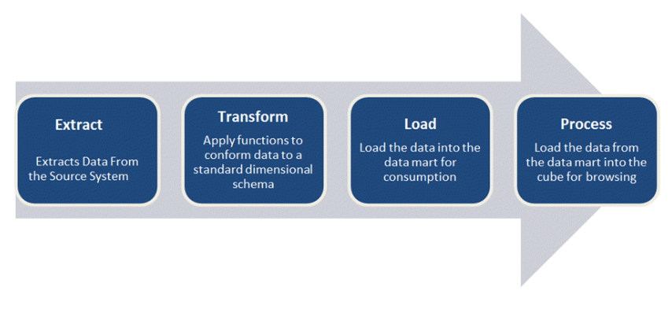
ROAD MAP of the ETL Testing process flow

Slide 6
EXTRACT
Extract relevant data
TRANSFORM
Transform data to DW (Data Warehouse) format
Cleansing of data :After the data is extracted, it will move into the next phase, of cleaning and conforming of data.

Slide 7
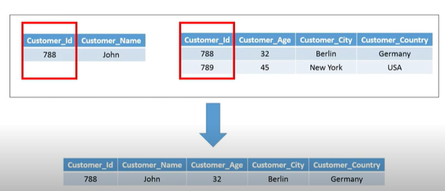
Data Transformation Methods
Data Joining

Slide 8
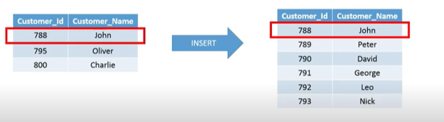
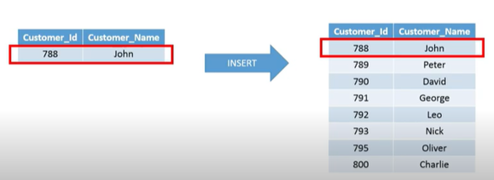
Data Duplication

Slide 9
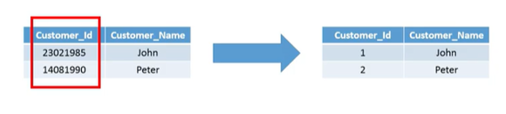
Keys Restructuring

Slide 10
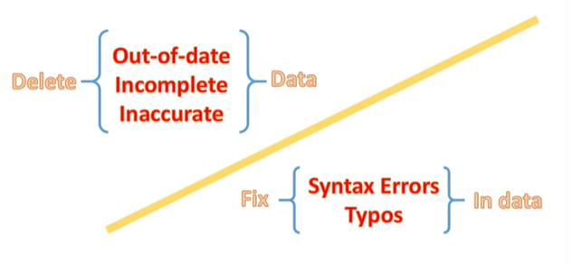
Data Cleansing

Slide 11
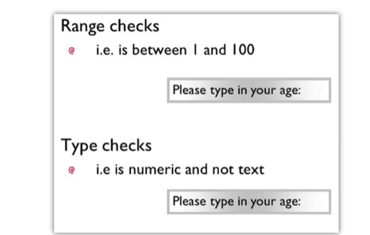
Data Validation

Slide 12
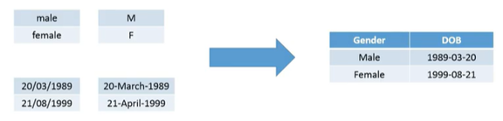
Data Formatting

Slide 13
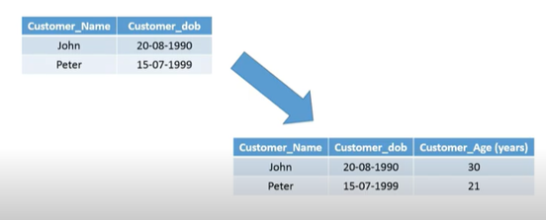
Data Derivation

Slide 14
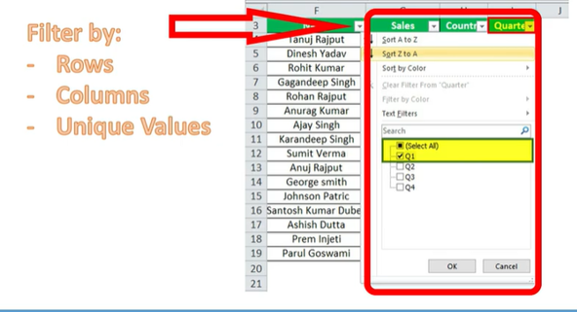
Data Filtering

Slide 15
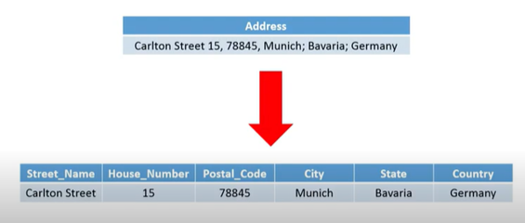
Data Splitting

Slide 16
LOAD
Load data into DW (Data Warehouse)
Build aggregates – Creating an aggregate is summarizing and storing data which is available in fact table prove the performance of end-user queries

Slide 17
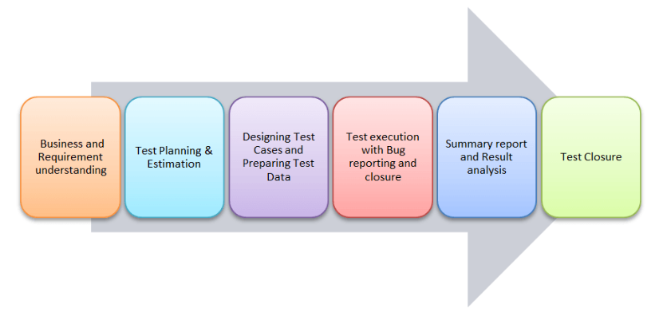
Different phases of ETL testing process

Slide 18
ETL testing is performed in five stages
Identifying data sources and requirements
Data acquisition
Implement business logics and dimensional Modelling
Build and populate data
Build Reports

Slide 19
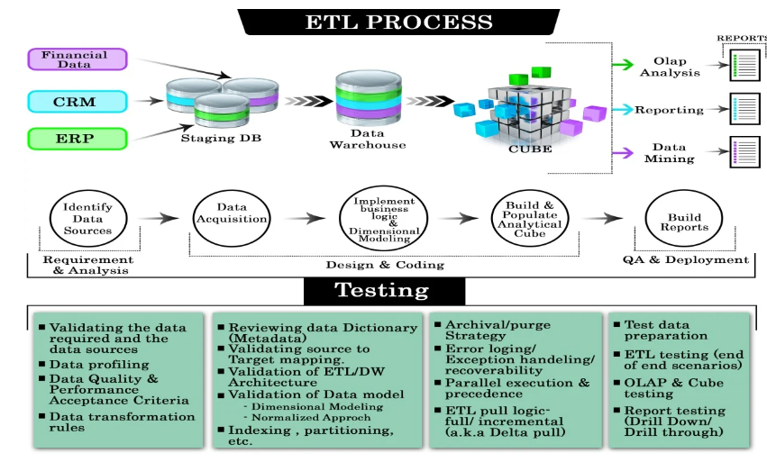

Slide 20
Types of ETL Testing
Production Validation Testing
“Table balancing” or “production reconciliation” this type of ETL testing is done on data as it is being moved into production systems.
To support your business decision, the data in your production systems has to be in the correct order.
Source to Target Testing (Validation Testing)
Such type of testing is carried out to validate whether the data values transformed are the expected data values

Slide 21
Application Upgrades
Such type of ETL testing can be automatically generated, saving substantial test development time.
This type of testing checks whether the data extracted from an older application or repository are exactly same as the data in a repository or new application.
Metadata Testing
Metadata testing includes testing of data type check, data length check and index/constraint check.

Slide 22
Data Completeness Testing
To verify that all the expected data is loaded in target from the source, data completeness testing is done.
Some of the tests that can be run are compare and validate counts, aggregates and actual data between the source and target for columns with simple transformation or no transformation.
Data Accuracy Testing
This testing is done to ensure that the data is accurately loaded and transformed as expected.

Slide 23
Data Transformation Testing
Testing data transformation is done as in many cases it cannot be achieved by writing one source SQL query and comparing the output with the target.
Multiple SQL queries may need to be run for each row to verify the transformation rules.
Data Quality Tests includes syntax and reference tests. In order to avoid any error due to date or order number during business process Data Quality testing is done.

Slide 24
Data Quality Testing
Reference Tests: It will check the data according to the data model. For example: Customer ID
Data quality testing includes number check, date check, precision check, data check , null check etc.
Incremental ETL testing
This testing is done to check the data integrity of old and new data with the addition of new data.
Incremental testing verifies that the inserts and updates are getting processed as expected during incremental ETL process.
GUI/Navigation Testing
This testing is done to check the navigation or GUI aspects of the front end reports.

Slide 25
ETL TEST SCENARIOS AND TEST CASES
Mapping doc validation
Verify mapping doc whether corresponding ETL information is provided or not. Change log should maintain in every mapping doc.
Validation
Validate the source and target table structure against corresponding mapping doc.
Source data type and target data type should be same
Length of data types in both source and target should be equal
Verify that data field types and formats are specified
Source data type length should not less than the target data type length
Validate the name of columns in the table against mapping doc.

Slide 26
Constraint Validation
Ensure the constraints are defined for specific table as expected
Data consistency issues
The data type and length for a particular attribute may vary in files or tables though the semantic definition is the same.
Misuse of integrity constraints
Completeness Issues
Ensure that all expected data is loaded into target table.
Compare record counts between source and target.
Check for any rejected records
Check data should not be truncated in the column of target tables
Check boundary value analysis
Compares unique values of key fields between data loaded to WH and source data

Slide 27
Correctness Issues
Data that is misspelled or inaccurately recorded
Null, non-unique or out of range data
Data Quality
Number check: Need to number check and validate it
Date Check: They have to follow date format and it should be same across all records
Precision Check
Data check
Null check
Null Validate
Verify the null values, where “Not Null” specified for a specific column.

Slide 28
Duplicate Check
Needs to validate the unique key, primary key and any other column should be unique as per the business requirements are having any duplicate rows
Check if any duplicate values exist in any column which is extracting from multiple columns in source and combining into one column
As per the client requirements, needs to be ensure that no duplicates in combination of multiple columns within target only

Slide 29
Date Validation
To know the row creation date
Identify active records as per the ETL development perspective
Identify active records as per the business requirements perspective
Sometimes based on the date values the updates and inserts are generated.
Data Cleanness
Unnecessary columns should be deleted before loading into the staging area

Slide 30
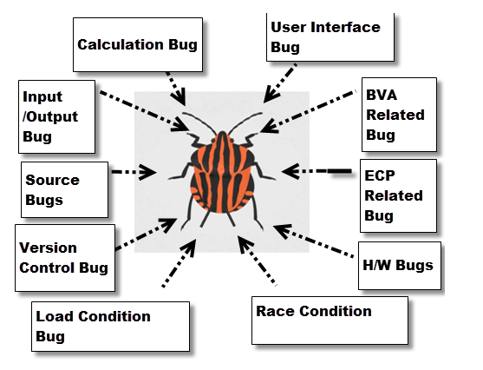
Types of bugs

Slide 31
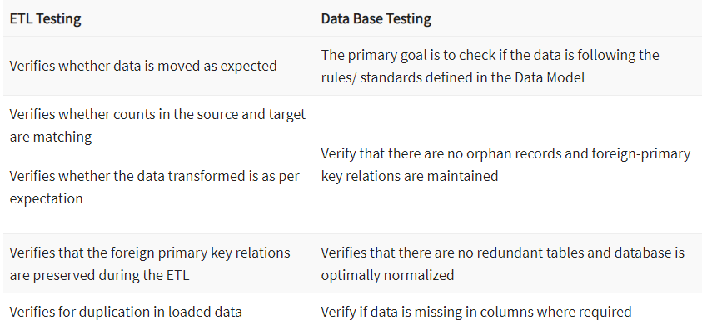
Difference between Database Testing and ETL Testing

Slide 32
Responsibilities of an ETL Tester
Test ETL software
Test components of ETL data ware house
Execute backend data-driven test
Create, design and execute test cases, test plans and test harness
Identify the problem and provide solutions for potential issues
Approve requirements and design specifications
Data transfers and Test flat file
Writing SQL queries for various scenarios like count test

Slide 33
QUESTIONS

Slide 34
THANK YOU

